Slide 1
fMRI: functional Magnetic Resonance Imaging
Louis James Vasseur, Julien Barozet

Slide 2
Magnetic Resonance Imaging(MRI)
Used in Medical Sector to analyze soft tissues, bones, organs and the nervous system
Technique that relies heavily on NMR (Nuclear Magnetic Resonance) properties of chemical nuclei to visualize brain activity via imaging

Slide 3
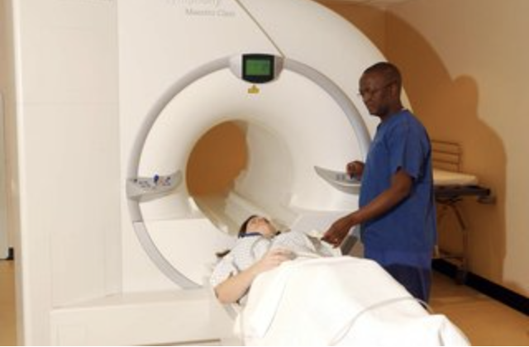
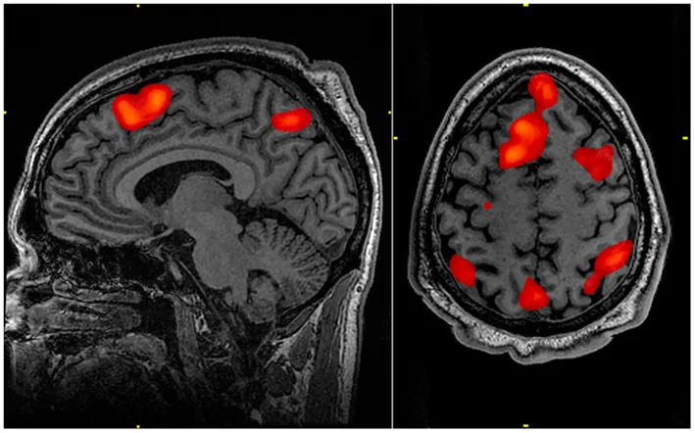
fMRI: functional Magnetic Resonance Imaging
We’ll break down this concept into 3 parts:
Magnetic Resonance (MR), through understanding of NMR
Imaging (I): how we project the MR onto an image
function (f): how the image is used to represent and analyze brain function

Slide 4
What is NMR ?
Nuclear Magnetic Resonance
Leverage resonance properties of chemical nuclei to correlate resonance frequencies to composition/structure of this same substance

Slide 5
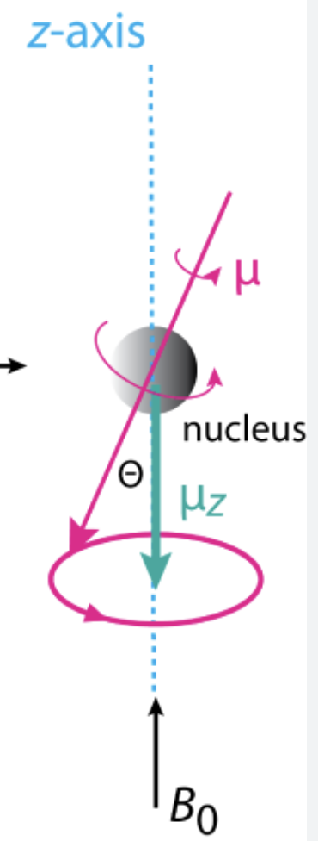
Correlating chemistry to signals
Particles in the nucleus have a spin quantum number I: quantum mechanical property that defines angular momentum. Can be spin-up (½) or spin-down (-½)
Example: ¹³C contain 1 unpaired neutron. Spin number = ½
¹²C contain only paired neutrons. Spin number = 0
If spin != 0: magnetic moment:
ν = (γ · B₀) / (2π)
This is called the Larmor Frequency and is determined the gyromagnetic ratio γ unique to each nucleus, Bo direction of magnetic field. We call a molecule w/ such a magnetic field NMR-active.
P.J. Hore, “Nuclear Magnetic Resonance,” 2nd Edition, (Oxford University Press, 2015)

Slide 6
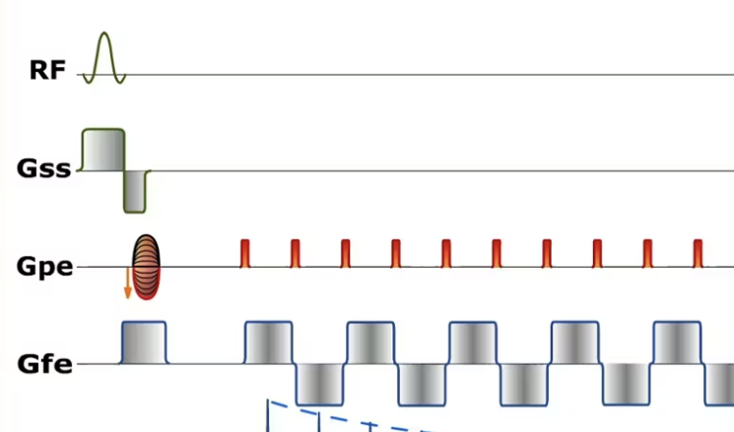
Manipulating Magnetization via pulses
We use different signal waveforms to manipulate this magnetization in different ways, which will then allow us to measure different properties (such as magnetization recovery times, etc…)
===> TIME-DOMAIN EXPERIMENT WHICH ALLOWS US TO MONITOR/ASSESS CHEMICAL PROPERTIES
Gradient Echo EPI pulse sequence- Imaios
FT
Example of a Gradient Echo EPI Sequence, pulse sequence which we’ll then be able to project onto a visual space using the Fourier Transform (k-space)
Extremely precise!

Slide 7
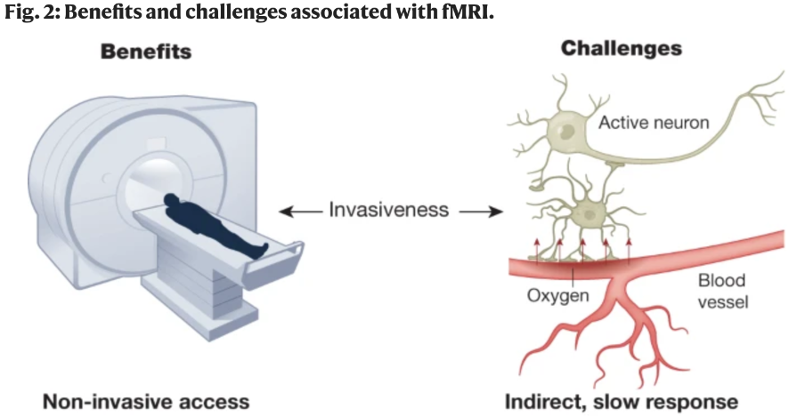
What about functional MRI (fMRI) ?
fMRI focuses on the change in the blood-flow and oxygen concentration of the brain
Leverage the fact that neuron activation triggers a bloodflow increase in the same area
Used in Medical Sector to assess risk about brain surgery and to understand how malfunctioning/functioning brains work
The challenge here is that the blood response due to neuron activation is influenced by other factors such as local field potentials for example.
Results given by fMRI are extremely efficient since they provide a great spatial and temporal activation map (map of “activated”, i.e oxygenated) areas of the brain but need to be carefully analyzed.
Functional neuroimaging as a catalyst for integrated neuroscience - nature.com

Slide 8
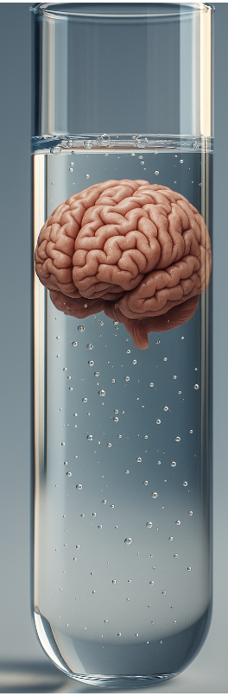
So… what’s the link?
MRI Scanner -NHS
In NMR experiments, we measure NMR signals to extract chemical data from a sample.
fMRIs works on a similar principle, except that the sample is the human brain inside the MRI scanner!
We correlate brain activity with chemical signals via the hydrogen nuclei in water from neural liquids. These are NMR-active! (see slide 5)
The blood-oxygen-level-dependent (BOLD) effect comes into play. Deoxyhemoglobin and oxyhemoglobin (paramagnetic/diamagnetic resp.), alter the magnetic field of the surrounding hydrogen molecules: studying this magnetic field will allow us to monitor blood flow in real time
Humorous image generated by ChatGPT! (prompt: give an image of a brain in a test tube)

Slide 9
An example of an fMRI scan
More oxygenated blood (less deoxyhemoglobin)-
This fMRI scan reflects brain activity maps when brain is recalling memories,
Sex, Lies & Brain Scans by Barbara J Sahakian and Julia Gottwald review – thinking out of the box (photo credit: John Graner)

Slide 10
Some Example Use Cases
Risk of brain Surgery : brain surgery can be useful for grave forms of epilepsy or brain tumors. fMRI is used to detect critical areas around the surgery area. We will look for motor control for example by asking the patient to move a finger showing the surgeon the area to avoid.
Alzheimer disease : Neurovascular coupling (phenomenon where neuron activation leads to blood flow) is disrupted, altering the BOLD signal significantly which appears on an fMRI signal. The 0.01–0.1 Hz BOLD signal of an Alzheimer-afflicted patient will present much lower-amplitude signals, which can appear on image

Slide 11
Conclusion
Summary :
fMRI is the most widely used technique for neuroimaging
It provides a strong, accurate and precise visual representation of the brain activity combined with the fact that it is not invasive
Despite the fact that blood flow analysis is still subject to external influences reducing precision
Future improvements :
Mainly 2 fronts for improvement : better understand signals emitted by neuronal system and reduce influence of external factors (noise, etc…) on the blood flow analysis

